Slide 1
Leveraging AMD Ryzen AI PCs: Mastering LLM and CNN in Practice
黃彥勲
Sean Huang
Notes:
AI應用啟航：CNN與LLM模型基礎與AMD Ryzen AI PC介紹
在AMD平台打造您的大型語言模型(LLM)應用

Slide 2
Lesson Outline
Overview
What are AMD RyzenTM AI PCs?
Primer to Computer Vision Tasks
Foundations of LLMs
Retrieval-Augmented Generation (RAG)
Function Calling Implementation
Notes:
24.10

Slide 3
Overview
Introduction
This course serves as an introductory guide for those interested in deploying AI solutions on AMD’s RyzenTM AI PCs. It includes a high level discussion on the foundation of CNNs and LLMs.
This is the first part of a 2-part course covering the theoretical foundations necessary to understand CNN and LLM application design philosophies. Part 2 will include hands-on code walkthroughs for example applications.
Resources
Code and lecture slides: https://github.com/jonathansimple/intro-to-llms
Notes:
Beginner friendly course

Slide 4
What Are AMD RyzenTM AI PCs?

Slide 5
AMD RyzenTM AI PC
An AMD AI PC is a PC that contains an NPU (neural processing unit). AMD AI PC will run AI applications on the CPU, GPU, and/or the NPU depending on the task. All three of these components are necessary for a PC to qualify as an AMD AI PC.
NPUs are AI specialist chips optimized for neural network computations (tensor operations, matrix multiplications, convolutions) and are more energy efficient

Slide 6
Components of an AMD RyzenTM AI PC
AMD XDNATM 2 Architecture
Ideal for inferencing, especially on battery-powered devices, when workload is predictable and model-specific (NPUs have hardware blocks tuned for certain operations)
NPU
AMD RDNATM 3.5 ARCHITECTURE
High-performance AI engine ideal for generative/content creation models (training + graphics + AI or other heavy parallel workloads)
GPU
AMD “ZEN 5” Architecture
Dedicated AI engine built to run models continuously at low power
CPU

Slide 7
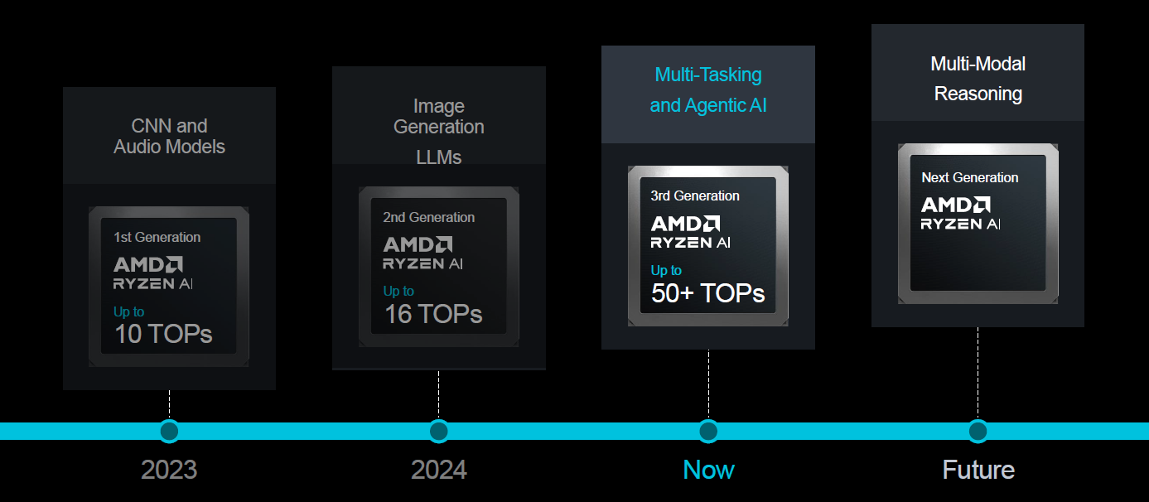
Performance Progression of AI PCs

Slide 8





Expanding Software Support for AMD Platforms
Hugging Face
PyTorch
AMD is building a hub of AI models on Hugging Face for deployment on AMD platforms
AMD is cooperating with the PyTorch Foundation and expanding AMD ROCm support for PyTorch
Ollama
LM Studio
AMUSE
Extensive support for AMD GPUs from Ollama demonstrates the growing accessibility of running LLMs locally
Run LLMs offline on your laptop
Create AI art with Stable Diffusion
Notes:
Software side support for AMD hardware is also developing

Slide 9
Advantages of AMD Ryzen AI PCs
Dedicated on-chip NPU
Better power efficiency
Integrated system-level AI: efficient on-device voice, vision, Copilot
Open standards & ecosystem support: Lemonade SDK
Slim, light form factors (especially in laptops)
Nvidia GPU systems on the other hand excels in heavy duty workloads, model fine-tuning, and gaming
It should also be noted that the CUDA ecosystem currently has more community support

Slide 10
Primer to Computer Vision Tasks

Slide 11
How to Recognize Different Images?
In computer vision, we differentiate between objects within an image by examining its features
Different ear shapes
Different body size
Different paw shapes
Notes:
Dog photo by Alvan Nee on Unsplash
Cat photo by Taylor Kopel on Unsplash

Slide 12
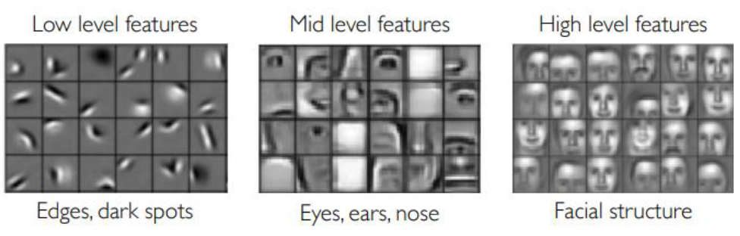
How Do We Get Features From An Image?
With convolution, we can extract low to high-level features from within an image
Notes:
Alexander Amini and Ava Amini, MIT 6.S191: Introduction to Deep Learning, IntroToDeepLearning.com

Slide 13
What is Convolution?
An image can be represented as a 3D (1D if grayscale) matrix. A convolution filter is slid over the image and the features are extracted using element-wise multiplication.
(120 x 1) + (5 x 1) + (100 x 1) =225
120 | 126 | 5 | 17 | 162
51 | 100 | 28 | 39 | 99
22 | 75 | 66 | 41 | 60
226 | 81 | 160 | 89 | 27
74 | 13 | 133 | 137 | 33
120 | 126 | 5 | 17 | 162
51 | 100 | 28 | 39 | 99
22 | 75 | 66 | 41 | 60
226 | 81 | 160 | 89 | 27
74 | 13 | 133 | 137 | 33
120 | 126 | 5 | 17 | 162
51 | 100 | 28 | 39 | 99
22 | 75 | 66 | 41 | 60
226 | 81 | 160 | 89 | 27
74 | 13 | 133 | 137 | 33
225 | 171 | 206
154 | 205 | 168
169 | 276 | 215
1 | 0 | 1
0 | 1 | 0
0 | 0 | 0
Image
Convolution filter/kernel (3x3)
Feature map

Slide 14
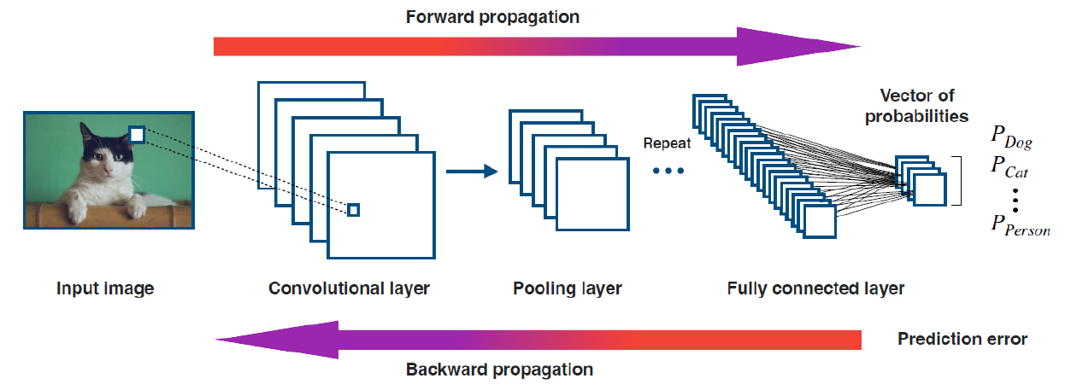
What is Convolution?
Notes:
Alexander Amini and Ava Amini, MIT 6.S191: Introduction to Deep Learning, IntroToDeepLearning.com
Pooling downsamples feature map while retaining the most representative information

Slide 15
What Can We Do With Features?
Image classification: assigning labels to an image (ResNet)
Label:
Cat

Slide 16
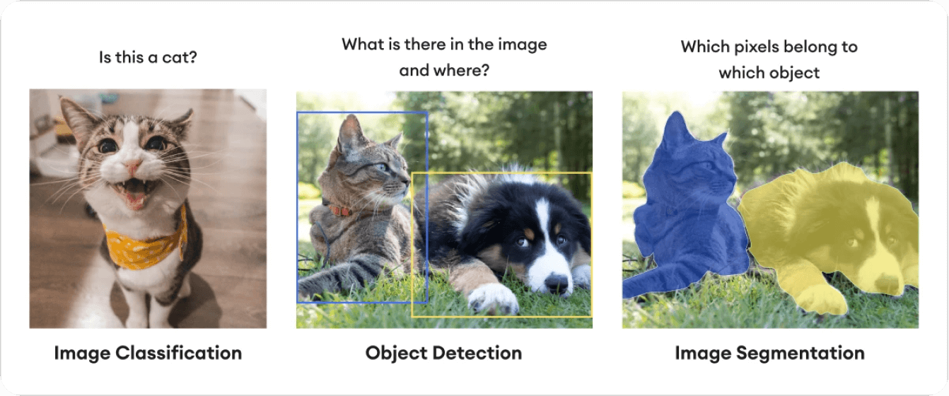
What Can We Do With Features?
Object detection: identify the location of objects within an image (YOLO)
Cat
Dog

Slide 17
What Can We Do With Features?
Segmentation: classify pixels within an image as certain categories (Segment Anything Model, SAM)

Slide 18
Foundations of LLMs

Slide 19
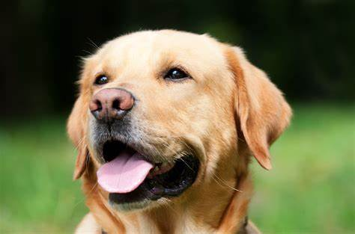
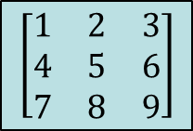
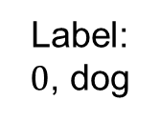
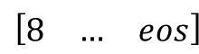
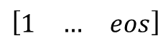
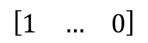
Comparison With CNN
CNN steps: convert image to matrix → inference → f(output)
Function f can be argmax for classification, for example
LLM steps: tokenize (string to token) → inference (generate) → decode (token to string)
Tokenization example:
"ChatGPT is amazing!" → ['Chat', 'G', 'PT', ' is', ' amazing', '!’] → [12345, 678, 91011, 314, 56789, 42]
cv2
$$\left[\begin{matrix}1 & 2 & 3 \\ 4 & 5 & 6 \\ 7 & 8 & 9\end{matrix}\right]$$
matmul
CNN
argmax
$$\left[\begin{matrix}1 & 2 & 3 \\ 4 & 5 & 6 \\ 7 & 8 & 9\end{matrix}\right]$$
Label: $0$, dog
$$\left[\begin{matrix}1 & 2 & 3 \\ 4 & 5 & 6 \\ 7 & 8 & 9\end{matrix}\right]$$
$$\left[\begin{matrix}1 & … & 0\end{matrix}\right]$$
Image
augmentation
Probability vector
tokenize
matmul
LLM
decode
“How are you?”
$$\left[\begin{matrix}1 & … & eos\end{matrix}\right]$$
$$\left[\begin{matrix}8 & … & eos\end{matrix}\right]$$
“I’m doing great”

Slide 20
Background For LLMs: Tokenizer
What are tokens?
LLMs need tokenizers to convert strings into tokens (numerical IDs) that the model can understand
Working with numerical values (float/int) is easier than strings
Every model has their own tokenizer
To better generalize unseen vocabulary during training, words are broken down into smaller parts (so one word can be more than one token)
Word seen during training: “unavailable”
“un” → 42
“avail” → 189
“able” → 76
New unknown word seen during inference: “unimaginable”
“un” → 42
“imagine” → ?
“able” → 76
Token 42 = not/opposite
Token 76 = can
So “unimaginable” should have a meaning related to being unable to do something
Notes:
Tokenizer set during training; if you use a tokenizer for one model on a different model, the output will break

Slide 21
What LLMs Are Out There?
GPT, Deepseek, Llama, gemma, Taide, Breeze, Mistral, Internvl, Qwen…
Each model has their own strengths and weaknesses:
GPT: most well rounded option out there with multilingual and multimodal support, but not open source and not locally hostable; good for pipeline testing during development before downscaling to local applications
Traditional Chinese support: Breeze, Taide; deepseek and qwen are also options when using Simplified to Traditional Chinese post processing
Multimodality (image + text): gemma3-4B or larger, internvl, BLIP2, CLIP, LLaVA, Claude
Multimodality (audio + text): qwen-audio, Whisper (STT), melo-TTS
Lightweight model for edge devices: gemma3-1B, ministral 3B
The baseline performance of new LLMs is rapidly improving – it’s all about picking what suits your use case best (model size, multi-lingual support, function calling, reasoning, etc.)

Slide 22
For More Theoretical LLM Background
Attention layer:
Queries, keys, and values
Self attention
Transformer architecture:
Encoder and decoder
Multi-head attention
Positional encoding
Training:
Loss functions (cross-entropy)
Flash attention
Context length
Parameter count

Slide 23
Retrieval-Augmented Generation (RAG)

Slide 24
What Is RAG (Retrieval-Augmented Generation)?
Problem: LLMs like GPT are trained on massive datasets, but they:
Can hallucinate (make up facts)
Do not have any knowledge of current events after their training cutoff date
Can’t access private or custom data during pretraining
For smaller models, they lack domain specific expertise
Solution: RAG – use external documents to Augment LLM’s answers
Step 1: Retrieve relevant documents from an external database (e.g., PDFs, websites)
Step 2: Generate an answer using both the user question and the retrieved content
This makes responses:
✅ More accurate
✅ More up-to-date
✅ Customizable to your domain
All without fine-tuning!

Slide 25
When to Use RAG?
Most tasks can be accomplished with RAG (without fine tuning the model)
To draw a parallel with CNNs, RAG is similar to using data augmentation (prompt engineering) and few shot learning to circumvent fine tuning
Applications:
Domain specific assistant: customer service, automatic inspection
Personalized service: can't be expected to load entire chat history or fine tune model for every user
Cheaply update model while maintaining model's core behavior

Slide 26
RAG Encoder
How does the retrieval system know which documents are relevant?
With RAG, you are working (generally) with 2 models
LLM model (generator) that answers your questions
Embedding model (encoder) that maps your question into the same vector space as your dataset (vector store)
The vector store finds the most similar documents (top-k) to the query vector (cosine similarity)

Slide 27
An Example RAG Framework
Query
Output
……
LLM
……
Top k most relevant context (cosine)
encoder
----------
----------
----------
encoder
(offline)
Reference documents
Vector database

Slide 28
RAG At Work
If you use an older model like gemma-2-2b-it and ask it:
Do you have any information on who the president of the United States is in 2025?
It will respond with:
I do not have access to real-time information, including future events. Therefore, I cannot tell you who the President of the United States will be in 2025.
With RAG:
According to the news sources you provided, the President of the United States in 2025 would be **Donald Trump**.

Slide 29
Best Practices for Improving RAG Results
Strategic chunking:
Use semantic chunking (by paragraph/topic) instead of fixed sizes, avoid splitting mid-topic (particularly for closely associated information like lists), add token overlap to maintain context continuity across chunks
Embedding model selection:
Use high quality embedding models (OpenAI text-embedding-3-small, Cohere, Sentence-BERT), or specialized models for your specific task (bge-m3 for Chinese text, CodeBERT for code)
Data cleanup:
Normalize whitespace, remove boilerplate, correct OCR errors
Retrieval post processing:
Rerank documents after retrieval, use metadata to encode hierarchy or use metadata as retrieval filter
Prompt optimization:
Insert retrieved chunks using structured context, use chain of thought prompts to reason across documents
Generator model selection:
Choose a high quality LLM suitable for your task

Slide 30
Function/Tool Calling: Using Natural Language to Interface with External APIs

Slide 31


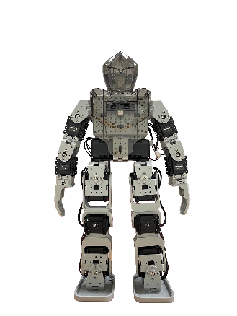

Tools/Function Calling
Objective: using the semantic understanding of large language models (LLMs), convert a user’s unstructured command into control signals for other applications with function calling
For LLMs, function calling refers to when the LLM infers the correct function to call and its input parameters from the user prompt
Applications: IoT, search (retrieve real-time data online or from local database), automated customer service (banking, booking), AI PC
Take two steps forward
[00 01 11 00]
Controller
Whisper
Gemma 2 2B
API
Speech to text
Decide which function to use and convert text to JSON
Using JSON data fields as input, call function
Spoken command as input
{“function”: “perform_action”, “action”: “walk forward, …”}
Perform action

Slide 32
Essential Components of Function Calling
Model: does the model support function calling?
Prompt: do the function descriptions describe the task clearly? Is the prompt clear?
External API: does the application have API support?

Slide 33
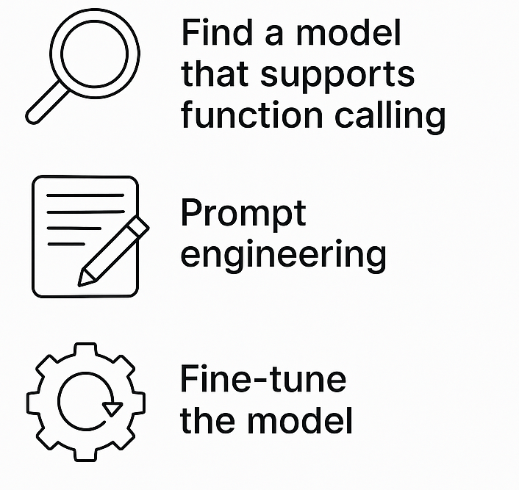
What Happens If You Lack the Essential Components?
Model: the model does not support function calling
GPT, mistral, deepseek, breeze, phi, gemma
(If model has good comprehension) Adjust function descriptions, provide examples for few shot learning
Train the model on public/custom function calling datasets*
Notes:
You can do anything you want if you fine tune the model

Slide 34
What Happens If You Lack the Essential Components?
Prompt: if the model supports function calling/has good text comprehension, how can you improve function calling performance in the following cases?
Function output format is incorrect
Few shot learning, use special tokens (<functional>, etc.)
Some functions are not getting called/called more than others
Make sure your function list is designed so that each function performs distinctly different tasks to avoid confusing the LLM
Check your model’s max input size, sometimes your function list may be too long for a small model
The model only outputs formatted text and lost the ability to chat normally
Adjust system prompt to instruct model to only use function call when applicable, consider using multi-agent systems (one for parsing functions, another for chatting)

Slide 35
What Happens If You Lack the Essential Components?
External API: does the application have official API support?
Yes
Then there’s no problem, just pick out the functions you need and determine what parameters to parse as inputs
No
Hack the application and write your own API
Find alternative applications

Slide 36
Our Model Can Call Functions, Now What?
✅ Model: does the model support function calling?
❓️ Prompt: do the function descriptions describe the task clearly? Is the prompt clear?
❓️ External API: does the application have API support?
Before we craft our prompt, we need to know what task we are performing.

Slide 37
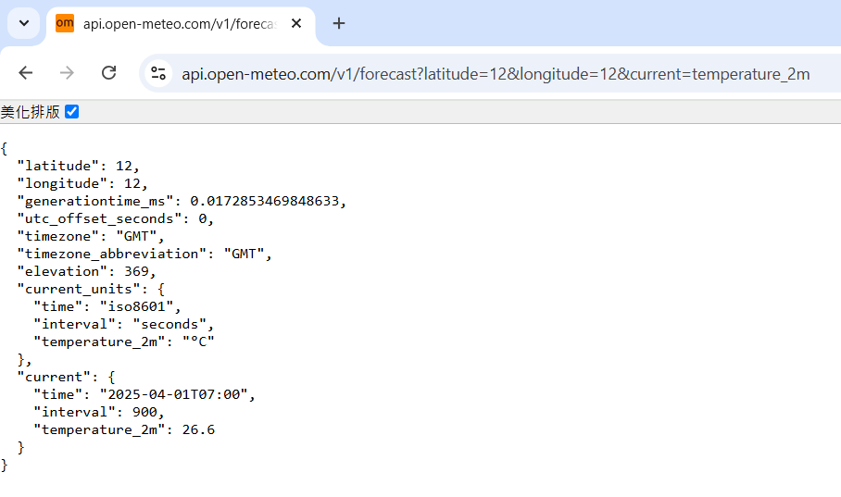
Our Model Can Call Functions, Now What?
Decide on which API you are using:
Example: Open-Meteo (free open source weather
forecast API)
Pick out the functions you will use:
Example: get_weather(latitude, longitude)
Input: (12, 12)
Output: json with current time and temperature
API supports other functions like wind speed,
hourly temperature, etc.
Next step: crafting functions/tools for LLM to use (description + prompts = use these APIs)
Open-Meteo’s API returns an easily parsed json
Notes:
latitude

Slide 38
Function Calling Prompt Crafting
A prompt for function calling contains the following:
General direction/role assignment
Function list
Function name
Description
Function parameter names
Function parameter descriptions
Required inputs
(Optional) Desired output format

Slide 39
Function Calling Prompt Crafting
General direction/role assignment
Example: “You are a helpful assistant with access to the following functions. Use them if required - ”
Assigning a role to a LLM can influence its output:
This affects tonal style, how strict/loose the model should be when deciding whether it should use functions or chat normally
Example: “You are a reliable, trustworthy expert on semiconductor manufacturing. You can answer anything related to your domain of expertise but you must decline to answer when asked about other topics. When applicable, use the functions provided below to help answer the query:”

Slide 40
Function Calling Prompt Crafting
Function list: a function list includes all of the functions you want the LLM to be able to call
You can think of this as a header file for the LLM
Comments are IMPORTANT

Slide 41
Function Calling Prompt Crafting
A single function in the list will have these parameters:
Function name: name of the function
Description: what the function does, when it should be used, how it should be used; as a rule of thumb, if an intern can’t tell how this function works, the LLM won’t be able to either
Function parameter names: the names of the inputs to the function
Function parameter descriptions: function input properties (bool, enum), can include textual description for complex use cases
Required inputs: which inputs must be included
Function output is not explicitly written in the parameters (but usually included in function description)
This is because the LLM’s job is to turn natural language into f(x), the API is what handles the output generation

Slide 42
Function Calling Prompt Crafting
Function declaration example:
Function name: get_weather
Description: Get the current temperature for the provided coordinates in Celsius.
Function parameter names: latitude, longitude
Function parameter descriptions: {"type": "number"} (additional comments and enumerator rule not needed)
Required inputs: latitude, longitude

Slide 43
Function Calling Prompt Crafting
Desired output format:
Some LLMs are already trained on function calling datasets and can output structured data
Sometimes, it can still be useful to specify a particular output format to improve stability
Recommended ways to format outputs:
Json
Token delimiters
Example:
If a function should be used, respond with the function name and its parameters in json format like so:
{"name": "function_name", "arguments": {"arg_1": "value_1", "arg_2": "value_2", ...}}

Slide 44
Putting Everything Together
You are a helpful assistant with access to the following functions. Use them if required -
{
"name": "get_weather",
"description": "Get the current temperature for the provided coordinates in Celsius.",
"parameters": {
"type": "object",
"properties": {
"latitude": {"type": "number"},
"longitude": {"type": "number"}
},
"required": ["latitude", "longitude"]
}
}
If a function should be used, respond with the function name and its parameters in json format like so:
{"name": "function_name", "arguments": {"arg_1": "value_1", "arg_2": "value_2", ...}}
User Query:

Slide 45
A More Complex Example
You are a helpful assistant with access to the following functions. Use them if required -
{
"name": "get_action_set",
"description": "Get the series of actions and the number of times each action needs to be performed in order",
"parameters": {
"type": "object",
"properties": {
"actions": {
"type": "array",
"description": "The actions that need to be performed in the order that is specified by the user. If an action has to be performed multiple times, then repeat the action entry for the same number specified by the user, e.g. "Take two steps forward" would turn into ["walk forward", "walk forward"]." ,
"items": {
"type": "string",
"enum": ["bow", "cheer", "scratch head", "handstand", "sit", "stand", "stabilize", "walk forward", "walk backward", "walk left", "walk right", "turn right", "turn left"],
}
},
},
"required": ["actions"]
}
}
If a function should be used, respond with the function name and its parameters in json format like so:
{"name": "function_name", "arguments": {"arg_1": "value_1", "arg_2": "value_2", ...}}
User Query:
Descriptions are useful when the parameter has special rules or is unintuitive (generally good to have regardless)
Enums are useful when you only expect a fixed set of values in the field

Slide 46
We Have Our Model and Prompt, Now What?
✅ Model: does the model support function calling?
✅ Prompt: do the function descriptions describe the task clearly? Is the prompt clear?
❓️ External API: does the application have API support?
The easy part. Integrate the LLM pipeline with your chosen API

Slide 47
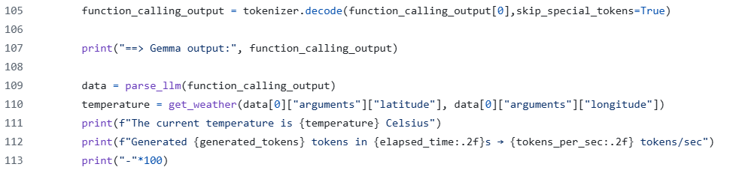
System Integration
Prepare your API calls to take in the inputs you specified
Prepare the API functions you require
LLM output
API call using LLM output as parameters
Don’t worry about the other arcane code, we’ll cover everything here in the practical section

Slide 48
Conclusion
In this course, we discussed:
What are AI PCs
Theoretical foundations of CNNs and LLMs
How to craft prompts to maximize a LLM's potential
Common LLM applications such as RAG and function calling
In the practical component, we will cover:
Perform basic computer vision tasks on Ryzen AI PCs
Create a RAG system
Perform function calling
How to inference using a variety of platforms (transformers, Ollama, Lemonade)

